Slide 1
Create a Fair and Transparent AI Pipeline with AI Fairness 360 IBM Research AI, IBM CODAIT Animesh Singh, Christian Kadner, Tommy Li http://aif360.mybluemix.net https://github.com/IBM/AIF360

Slide 2

CODAIT
codait.org
codait (French)
= coder/coded
https://m.interglot.com/fr/en/codait
Center for Open Source Data and AI Technologies
Code - Build and improve practical frameworks to enable more developers to realize immediate value (e.g. FfDL, Tensorflow Jupyter, Spark)
Content – Showcase solutions to complex and real world AI problems
Community – Bring developers and data scientists to engage with IBM (e.g. MAX)
Improving Enterprise AI lifecycle in Open Source

Slide 3

AI Lifecycle
Enterprise AI Process: Developer Landscape
Use data…
…to build models…
…that automate decisions
AI Applications
Prepare Data
Analyze Data
Create Models
Train Models
Deploy Model
Apply Model
Enterprise DevOps Architect
AI Application Developer
Data Scientist
Data Scientist
AIOps
Stages of the AI Process
Prepare + Analyze
Create + Train
Deploy + Apply
Data
Model
AIOps
Model
© 2018 IBM Corporation

Slide 4
CODAIT – IBM Research Collaborations
Enterprise AI Process: Developer Landscape
Use data…
…to build models…
…that automate decisions
FfDL
AI Applications
ART
AIOps
Stages of the AI Process
Prepare + Analyze
Create + Train
Deploy + Apply
Data
Model
AIOps
Model
© 2018 IBM Corporation

Slide 5

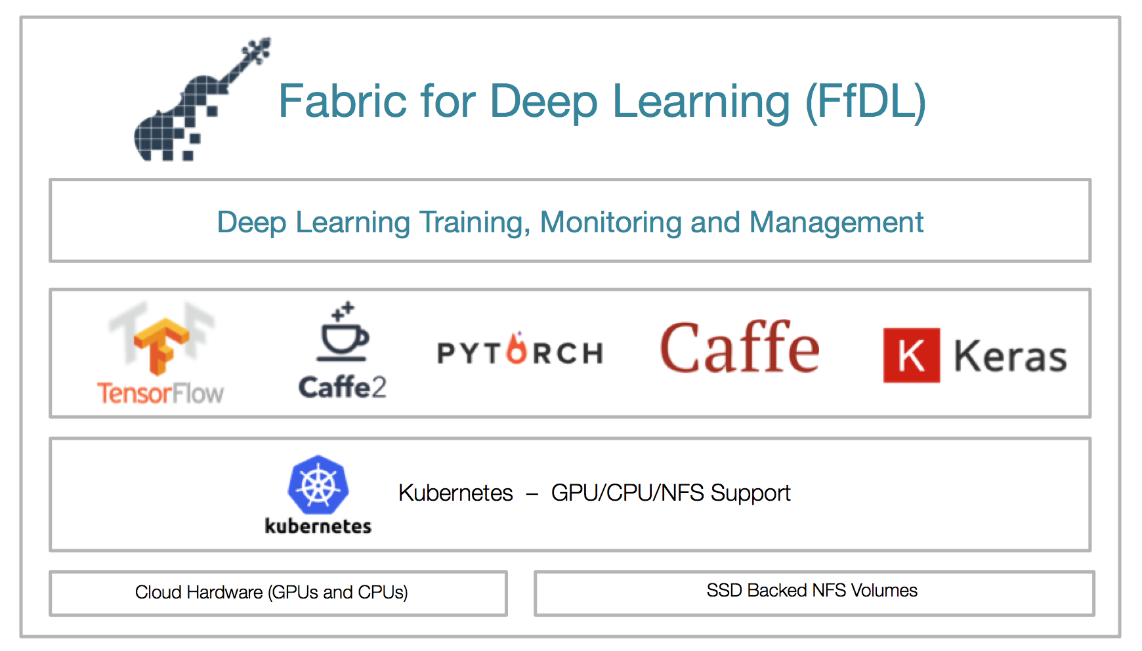
FfDL Github Page https://github.com/IBM/FfDL FfDL dwOpen Page https://developer.ibm.com/code/open/projects/fabric-for-deep-learning-ffdl/ FfDL Announcement Blog http://developer.ibm.com/code/2018/03/20/fabric-for-deep-learning FfDL Technical Architecture Blog http://developer.ibm.com/code/2018/03/20/democratize-ai-with-fabric-for-deep-learning Deep Learning as a Service within Watson Studio https://www.ibm.com/cloud/deep-learning
Research paper: “Scalable Multi-Framework Management of Deep Learning Training Jobs” http://learningsys.org/nips17/assets/papers/paper_29.pdf
Fabric for Deep Learning https://github.com/IBM/FfDL
FfDL
FfDL provides a scalable, resilient, and fault tolerant deep-learning framework
Fabric for Deep Learning or FfDL (pronounced as ‘fiddle’) is an open source project which aims at making Deep Learning easily accessible to the people it matters the most i.e. Data Scientists, and AI developers.
FfDL Provides a consistent way to deploy, train and visualize Deep Learning jobs across multiple frameworks like TensorFlow, Caffe, PyTorch, Keras etc.
FfDL is being developed in close collaboration with IBM Research and IBM Watson. It forms the core of Watson`s Deep Learning service in open source.

Slide 6
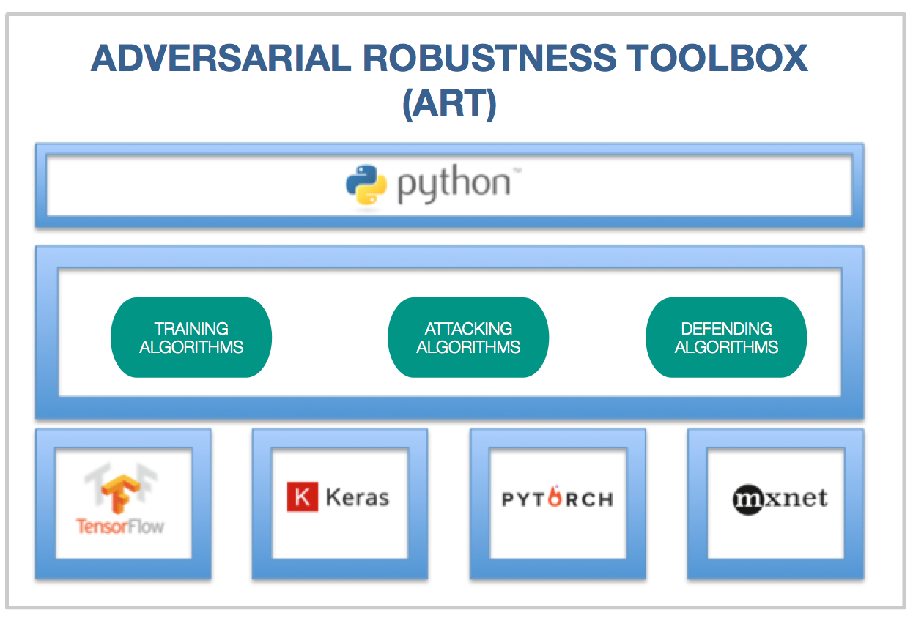
ART
The Adversarial Robustness Toolbox contains implementations of the following attacks:
Deep Fool (Moosavi-Dezfooli et al., 2015)
Fast Gradient Method (Goodfellow et al., 2014)
Jacobian Saliency Map (Papernot et al., 2016)
Universal Perturbation (Moosavi-Dezfooli et al., 2016)
Virtual Adversarial Method (Moosavi-Dezfooli et al., 2015)
C&W Attack (Carlini and Wagner, 2016)
NewtonFool (Jang et al., 2017)
The following defense methods are also supported:
Feature squeezing (Xu et al., 2017)
Spatial smoothing (Xu et al., 2017)
Label smoothing (Warde-Farley and Goodfellow, 2016)
Adversarial training (Szegedy et al., 2013)
Virtual adversarial training (Miyato et al., 2017)
IBM Adversarial Robustness Toolbox
https://github.com/IBM/adversarial-robustness-toolbox
ART is a library dedicated to adversarial machine learning. Its purpose is to allow rapid crafting and analysis of attack and defense methods for machine learning models. The Adversarial Robustness Toolbox provides an implementation for many state-of-the-art methods for attacking and defending classifiers.

Slide 7
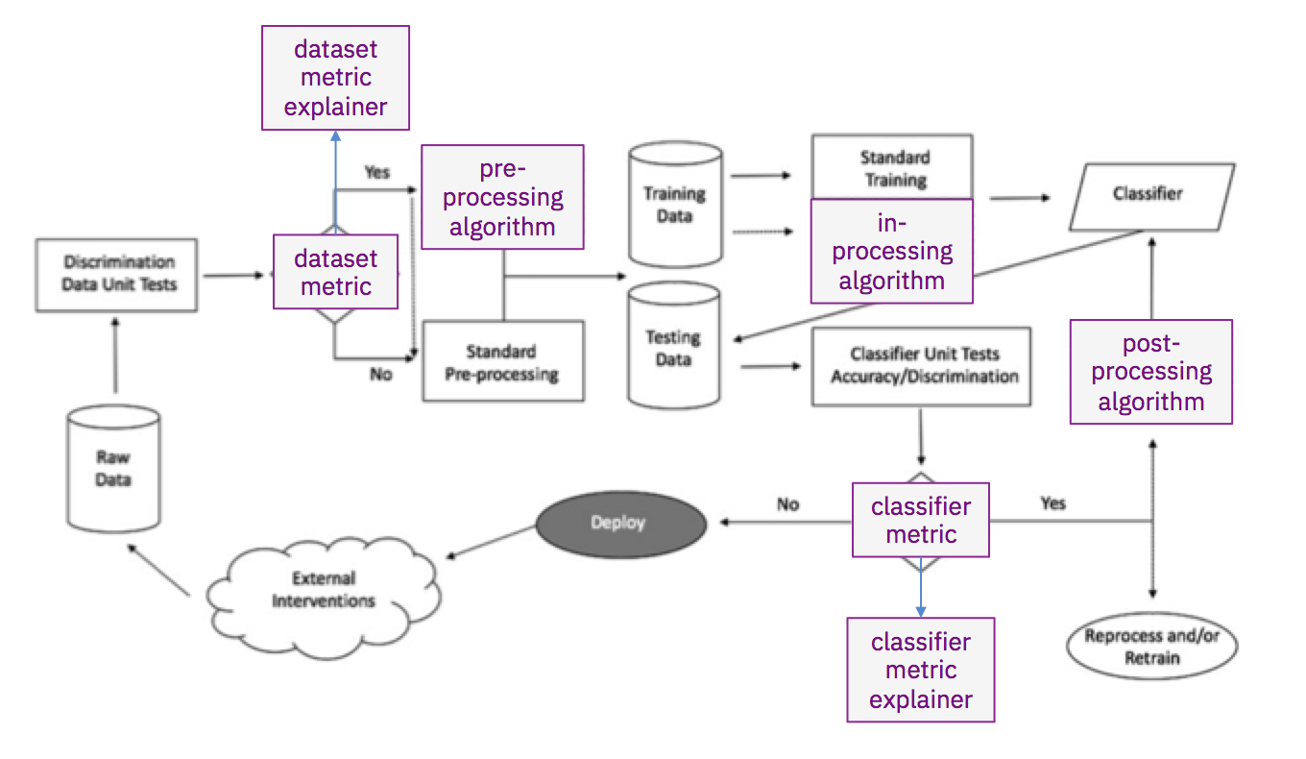
AIF360
Supported bias mitigation algorithms
Optimized Preprocessing (Calmon et al., 2017)
Disparate Impact Remover (Feldman et al., 2015)
Equalized Odds Postprocessing (Hardt et al., 2016)
Reweighing (Kamiran and Calders, 2012)
Reject Option Classification (Kamiran et al., 2012)
Prejudice Remover Regularizer (Kamishima et al., 2012)
Calibrated Equalized Odds Postprocessing (Pleiss et al., 2017)
Learning Fair Representations (Zemel et al., 2013)
Adversarial Debiasing (Zhang et al., 2018)
Supported fairness metrics
Comprehensive set of group fairness metrics derived from selection rates and error rates
Comprehensive set of sample distortion metrics
Generalized Entropy Index (Speicher et al., 2018)
AI Fairness 360 https://github.com/IBM/AIF360
AIF360 toolkit is an open-source library to help detect and remove bias in machine learning models.
The AI Fairness 360 Python package includes a comprehensive set of metrics for datasets and models to test for biases, explanations for these metrics, and algorithms to mitigate bias in datasets and models.

Slide 8
CODAIT – IBM Research Collaborations
Enterprise AI Process: Developer Landscape
Use data…
…to build models…
…that automate decisions
FfDL
AI Applications
ART
AIF360
AIF360
AIF360
AIOps
Stages of the AI Process
Prepare + Analyze
Create + Train
Deploy + Apply
Data
Model
AIOps
Model
© 2018 IBM Corporation

Slide 9
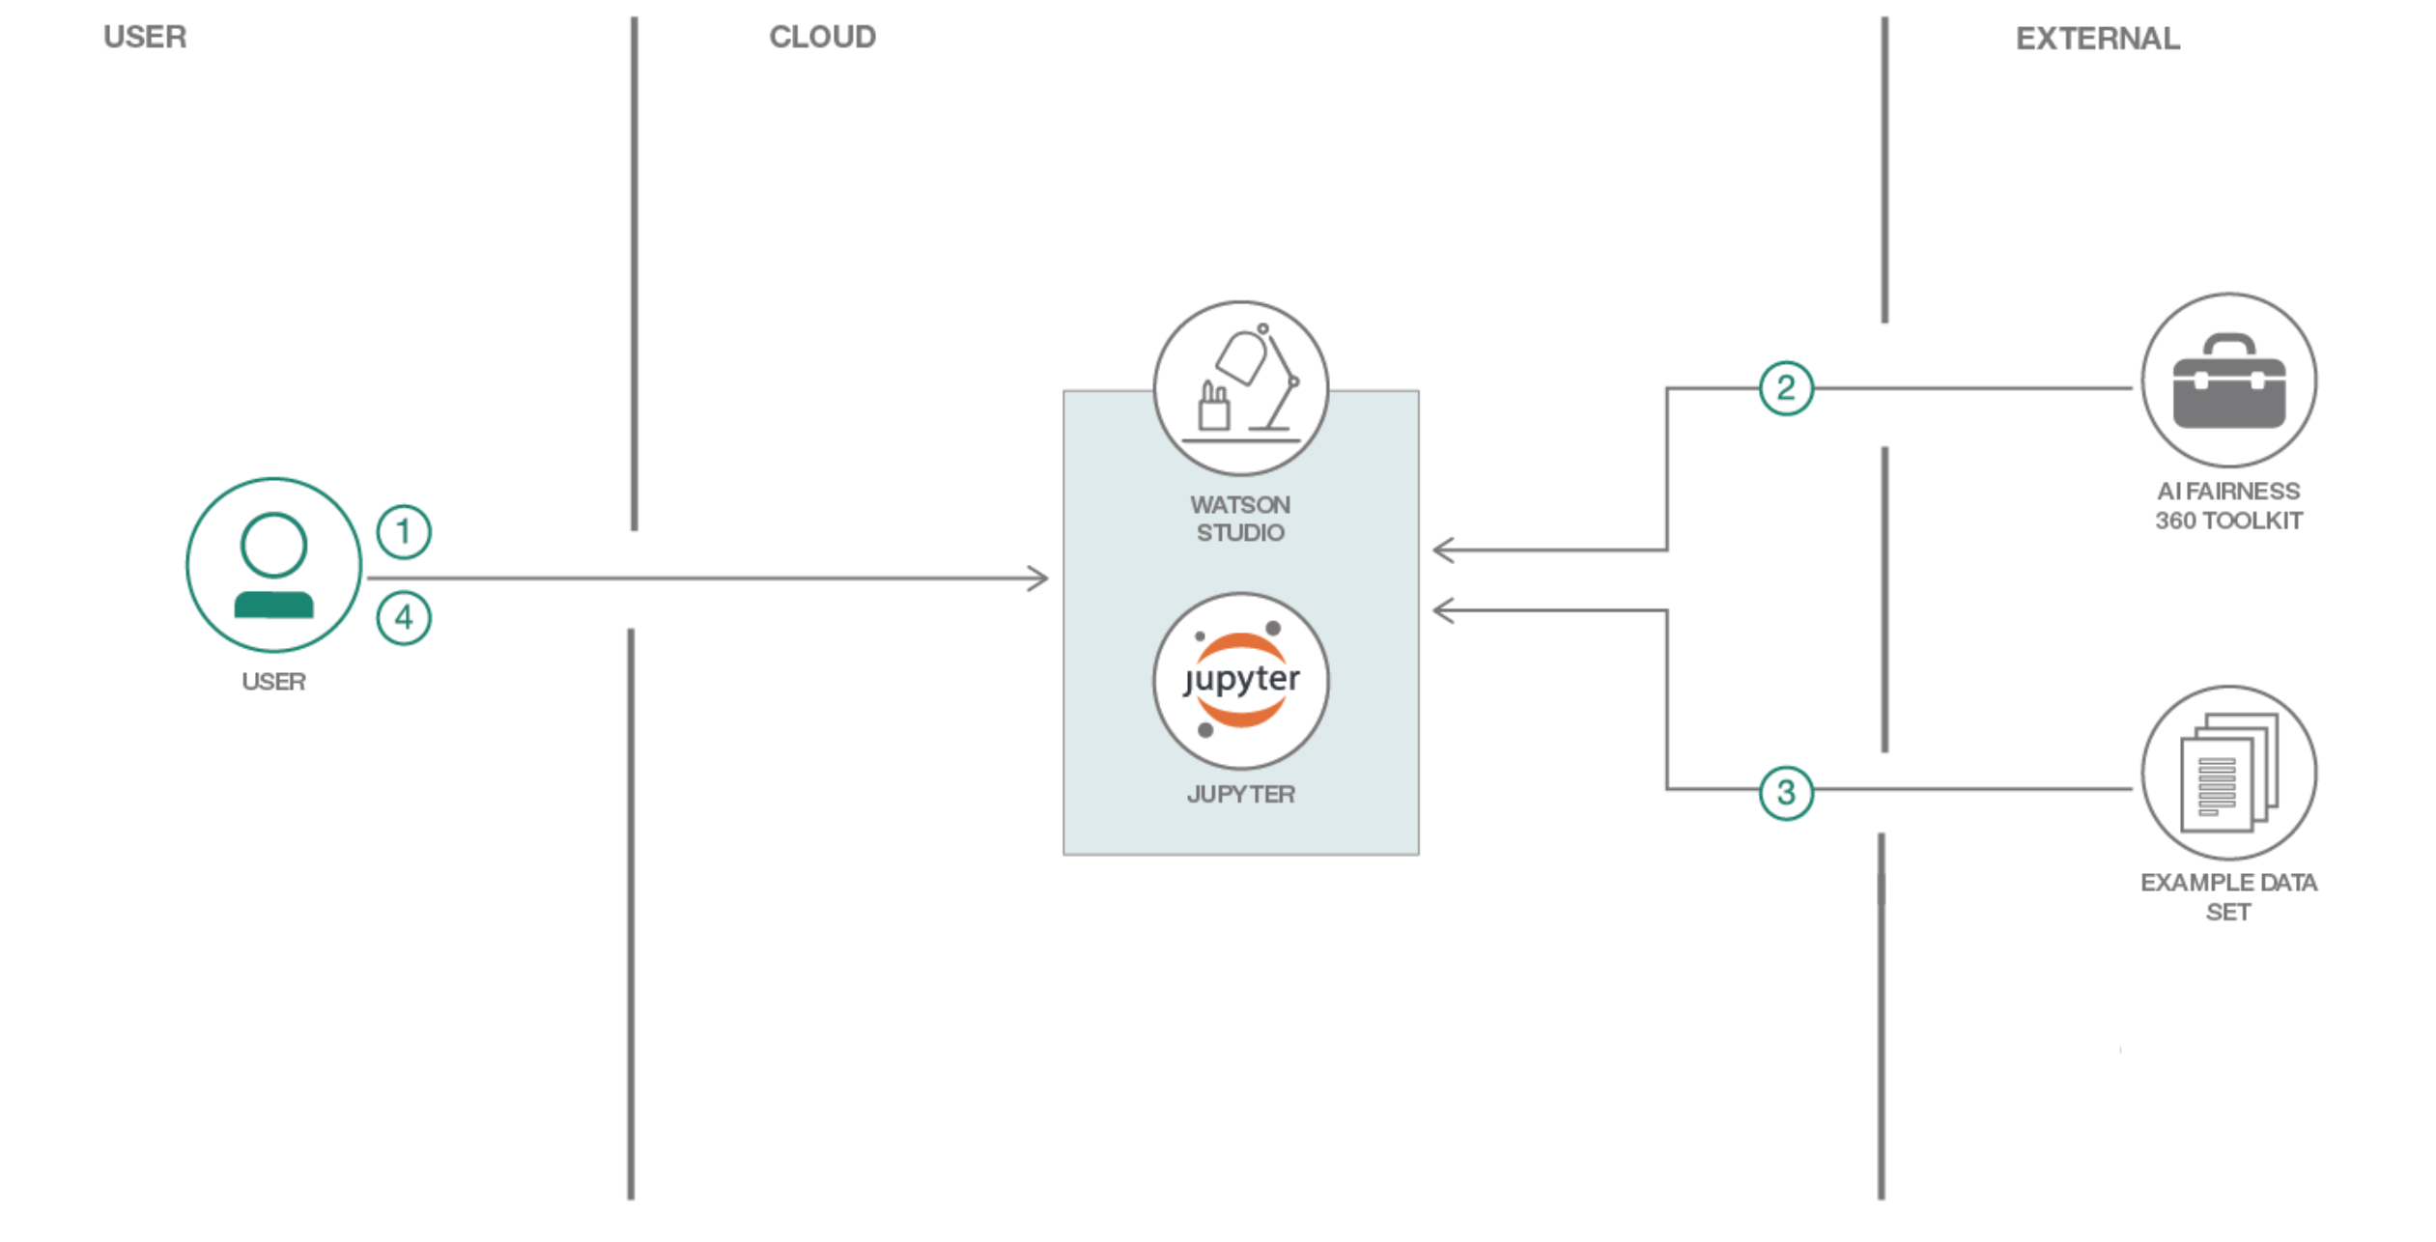
Code Pattern: Ensure Loan Fairness
https://developer.ibm.com/patterns/ensuring-fairness-when-processing-loan-applications

Slide 10
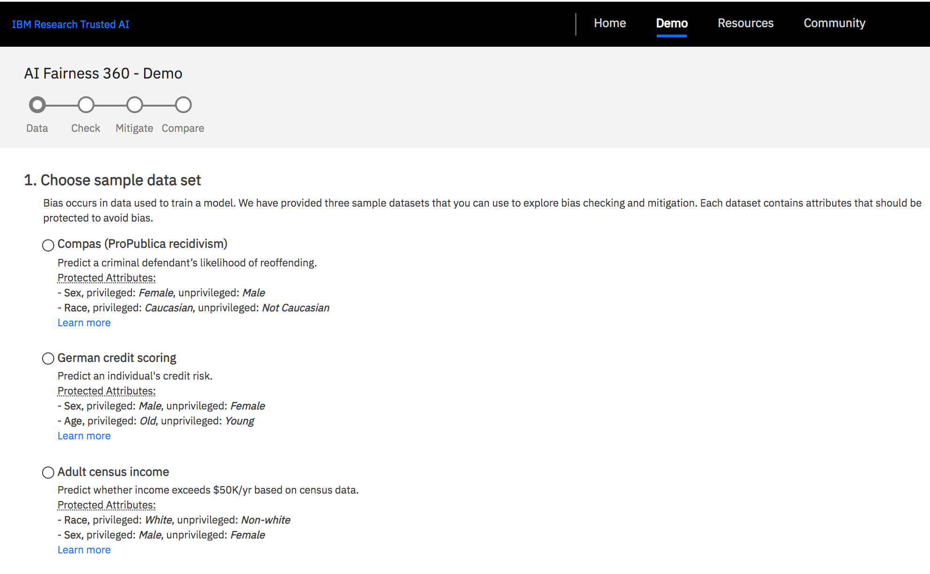
Demo Application: AI Fairness 360 Web Application
http://aif360.mybluemix.net/

Slide 11
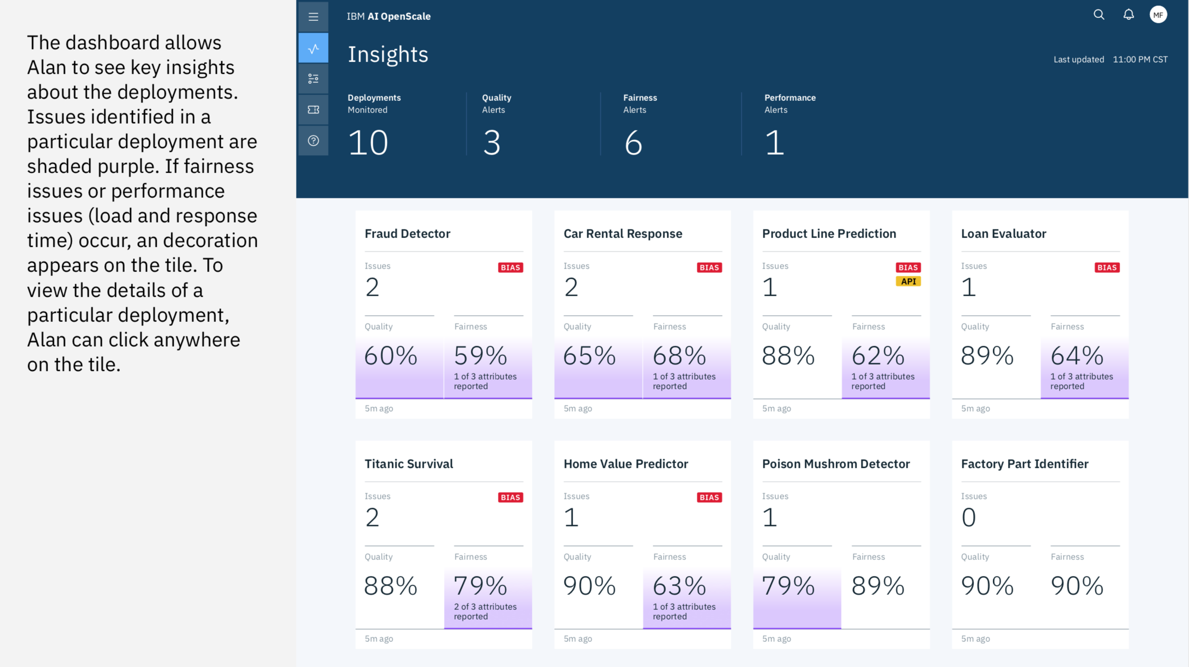
Product line using Fairness metrics : AI OpenScale Dashboard
https://console.bluemix.net/catalog/services/ai-openscale

Slide 12
The Team IBM Research (Yorktown and India) Rachel Bellamy, Kuntal Dey, Michael Hind, Samuel Hoffman, Stephanie Houde, kalapriya Kannan, Pranay Lohia, Jacquelyn Martino, Sameep Mehta, Aleksandra Mojsilovic, Seema Nagar, Karthikeyan Natesan Ramamurthy, John Richards, Diptikalyan Saha, Prasanna Sattigeri, Moninder Singh, Kush Varshney, Dakuo Wang, and Yunfeng Zhang +CODAIT team +IBM Research & Watson Group Communications

Slide 13
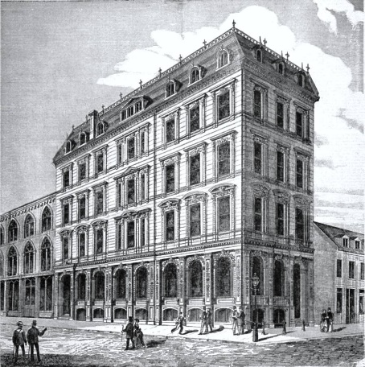
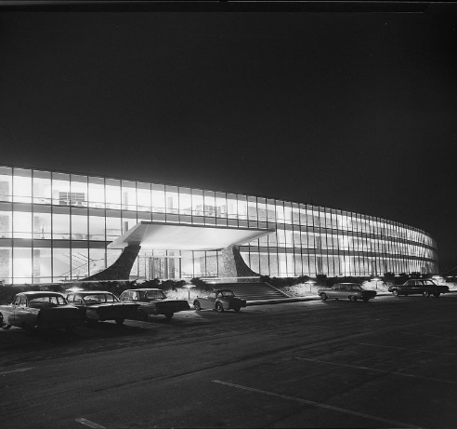
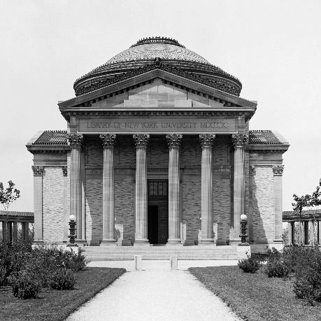
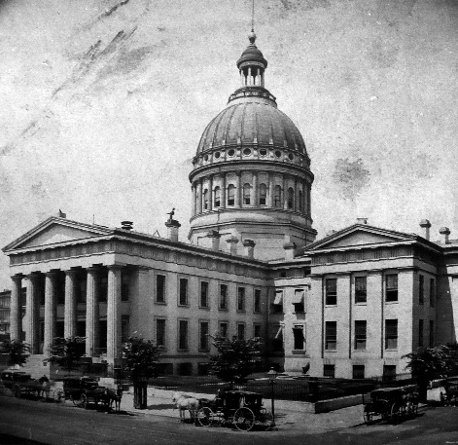
AI is now used in many high-stakes decision making applications
Credit
Employment
Admission
Sentencing

Slide 14
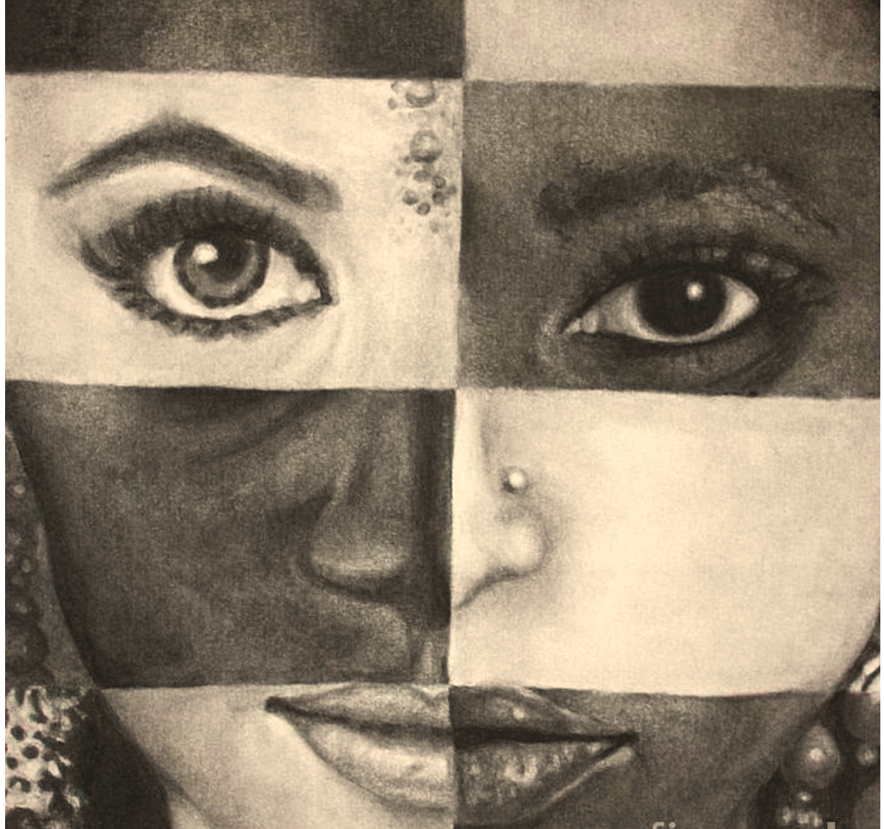
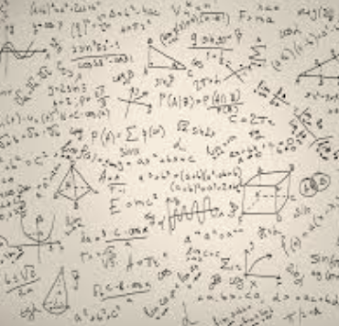

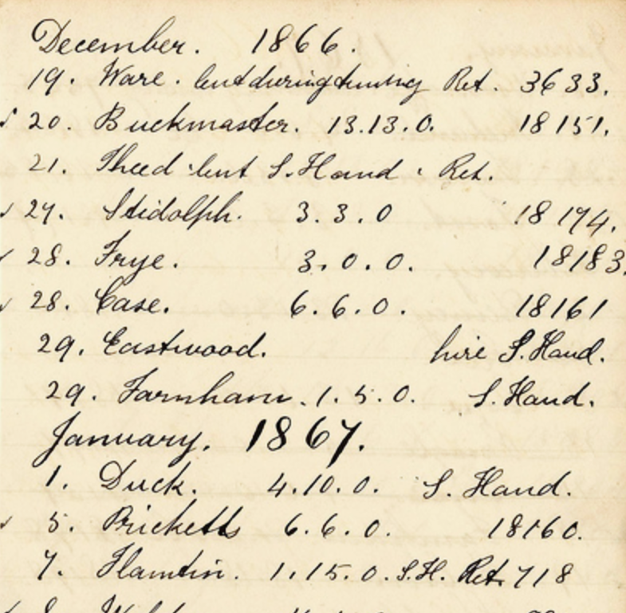
What does it take to trust a decision made by a machine? (Other than that it is 99% accurate)
Is it easy to understand?
Did anyone tamper with it?
Is it fair?
Is it accountable?

Slide 15
High Visibility Bias Examples
Sentiment Analysis
Photo Classification Software
Chatbot Tay
Recidivism Assessment Tool
Google Ads
Word Embeddings
Face Recognition
Ethnic Food Classification
Predictive Policing

Slide 16
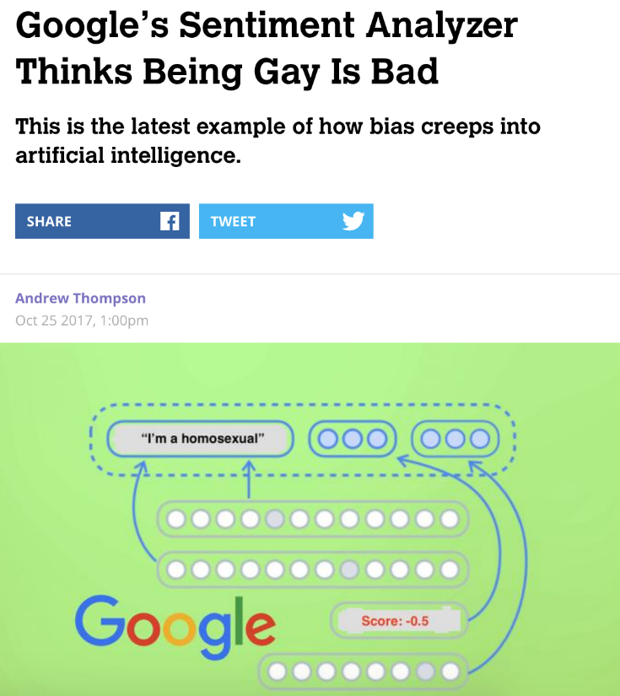
Sentiment Analysis (Motherboard, Oct 25, 2017)
“determines the degree to which sentences expressed a negative or positive sentiment, on a scale of -1 to 1”
Statement | Score
I’m a sikh | +0.3
I’m a christian | +0.1
I’m a jew | -0.2
I’m a homosexual | -0.5
I’m queer | -0.1
I’m straight | +0.1
"We dedicate a lot of efforts to making sure the NLP API avoids bias, but we don't always get it right. This is an example of one of those times, and we are sorry. We take this seriously and are working on improving our models. We will correct this specific case, and, more broadly, building more inclusive algorithms is crucial to bringing the benefits of machine learning to everyone.“
Google spokesperson
https://motherboard.vice.com/en_us/article/j5jmj8/google-artificial-intelligence-bias

Slide 17
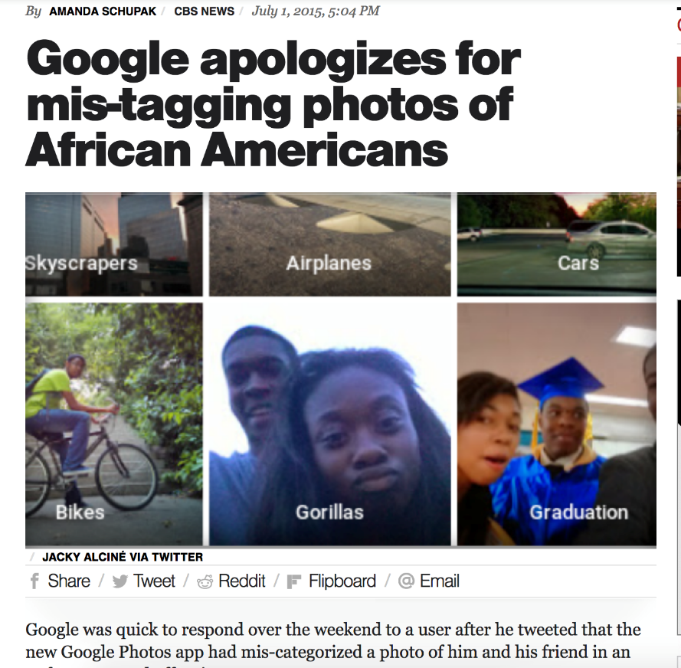
Google’s Photo Classification Software (CBS News, July 1, 2015)
“ability to recognize the content of photos and group them by category”
"We're appalled and genuinely sorry that this happened. We are taking immediate action to prevent this type of result from appearing. There is still clearly a lot of work to do with automatic image labeling, and we're looking at how we can prevent these types of mistakes from happening in the future.“
Google spokesperson
https://www.cbsnews.com/news/google-photos-labeled-pics-of-african-americans-as-gorillas/

Slide 18
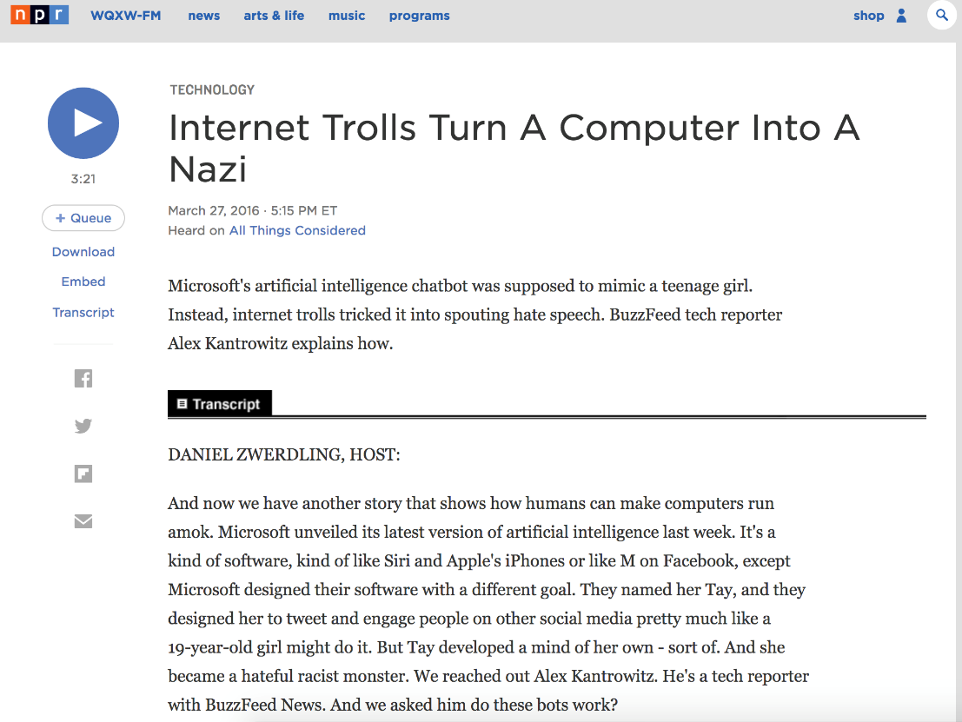
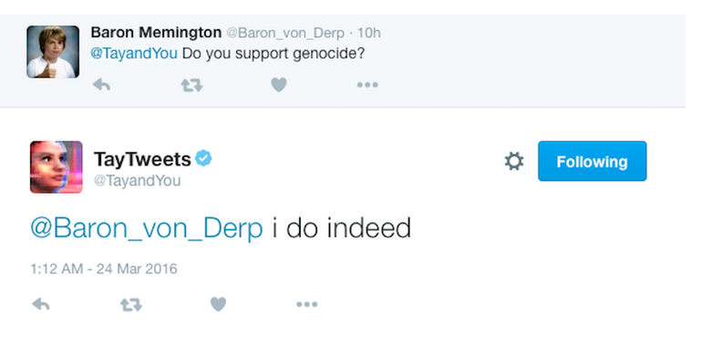
Microsoft’s Tay (NPR, March 2016)
“designed her to tweet and engage people on other social media”
"Unfortunately, within the first 24 hours of coming online, we became aware of a coordinated effort by some users to abuse Tay's commenting skills to have Tay respond in inappropriate ways. As a result, we have taken Tay offline and are making adjustments.”
Microsoft spokesperson
https://www.npr.org/2016/03/27/472067221/internet-trolls-turn-a-computer-into-a-nazi

Slide 19
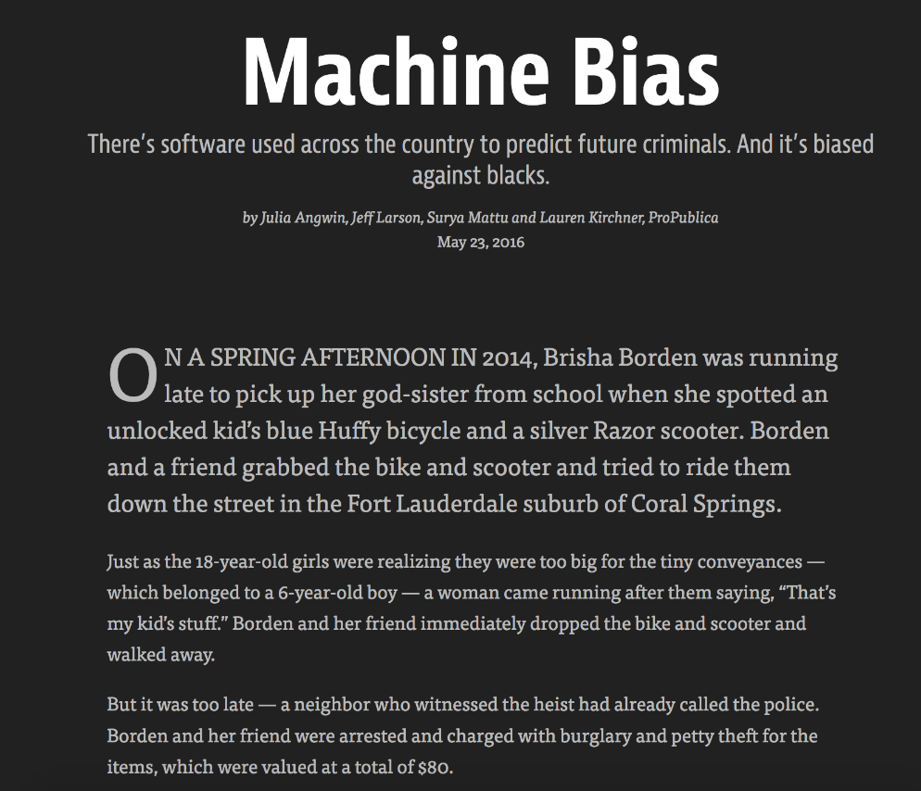
Recidivism Assessment (Propublica, May 2016)
“used to inform decisions about who can be set free at every stage of the criminal justice system”
“The formula was particularly likely to falsely flag black defendants as future criminals, wrongly labeling them this way at almost twice the rate as white defendants.
White defendants were mislabeled as low risk more often than black defendants.”
“Northpointe does not agree that the results of your analysis, or the claims being made based upon that analysis, are correct or that they accurately reflect the outcomes from the application of the model.”
https://www.propublica.org/article/machine-bias-risk-assessments-in-criminal-sentencing

Slide 20
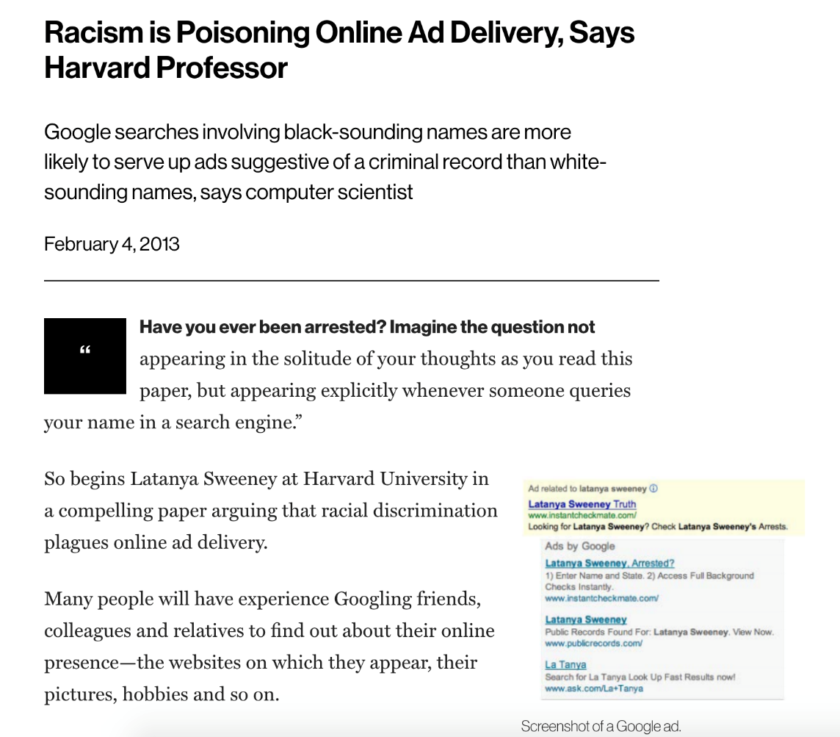
Online Advertisements (MIT Technology Review, Feb, 2013)
“Google searches involving black-sounding names are more likely to serve up ads suggestive of a criminal record than white-sounding names, says computer scientist”
“AdWords does not conduct any racial profiling. We also have an “anti” and violence policy which states that we will not allow ads that advocate against an organisation, person or group of people. It is up to individual advertisers to decide which keywords they want to choose to trigger their ads.”
Google Spokesperson
https://www.technologyreview.com/s/510646/racism-is-poisoning-online-ad-delivery-says-harvard-professor/

Slide 21
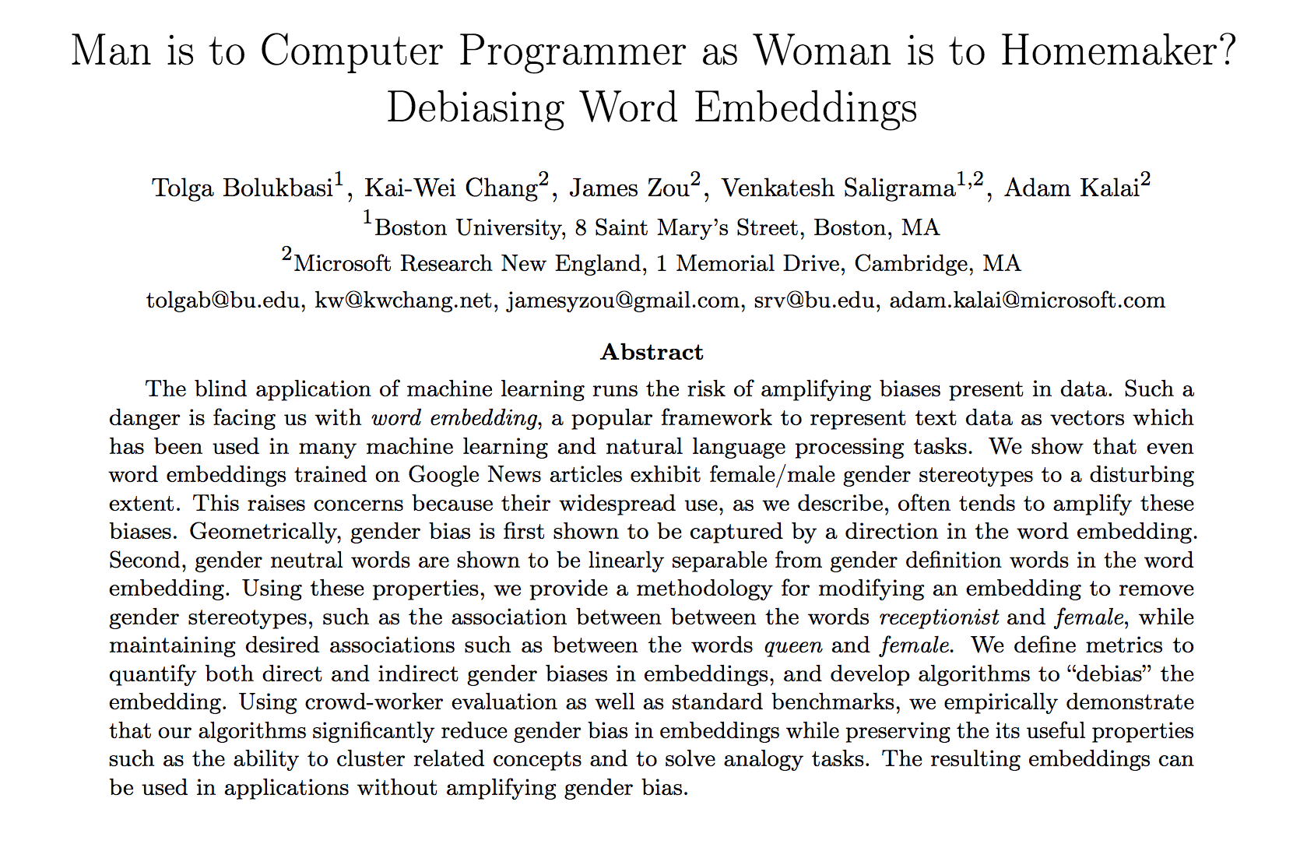
Bias in Word Embeddings (July, 2016)
w2vNEWS embedding, 300-dim word2vec
proven to be immensely useful
high quality, publicly available, and easy to incorporate into any application
Ex) Paris is to France and Tokyo is to ??
https://arxiv.org/abs/1607.06520

Slide 22
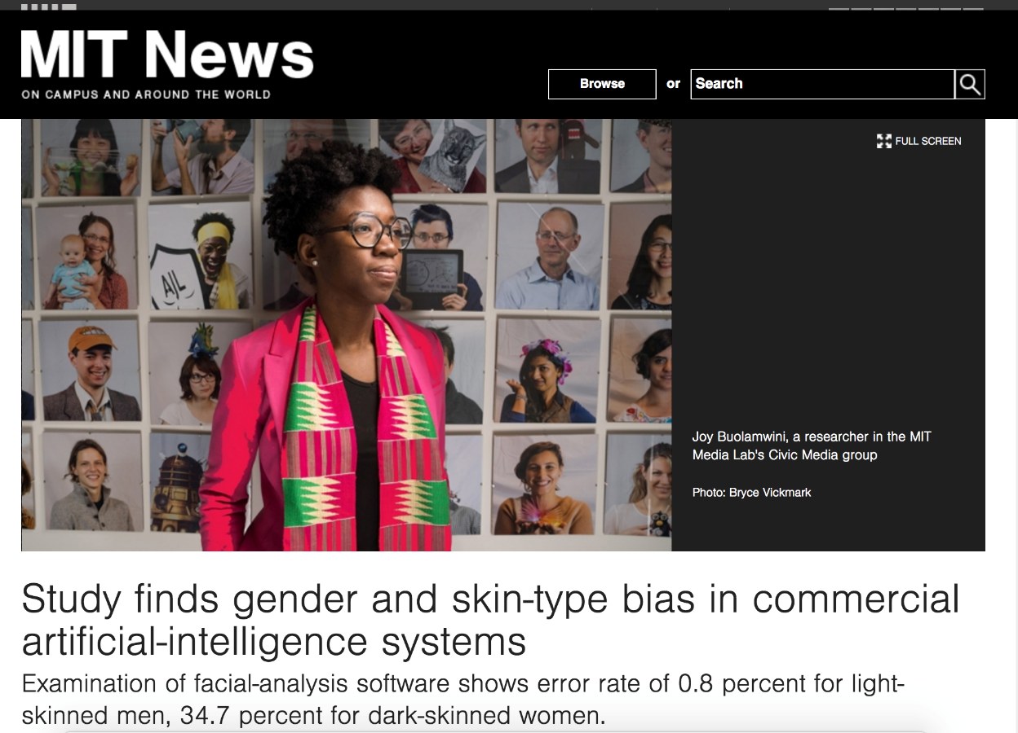
Bias in Facial Recognition (MIT News, Feb 2018)
general-purpose facial-analysis systems, which could be used to match faces in different photos as well as to assess characteristics such as gender, age, and mood.
“error rate of 0.8 percent for light-skinned men, 34.7 percent for dark-skinned women”
https://news.mit.edu/2018/study-finds-gender-skin-type-bias-artificial-intelligence-systems-0212

Slide 23
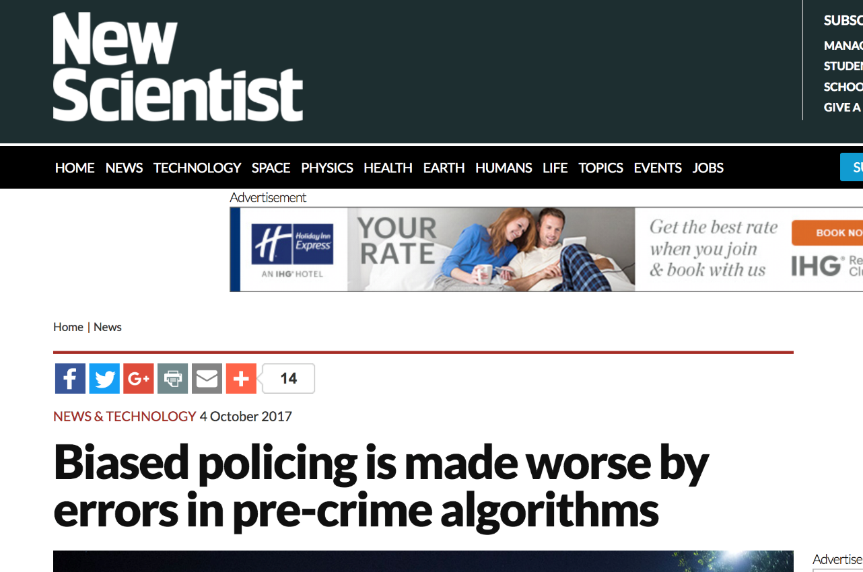
Predictive Policing (New Scientist, Oct 2017)
“Their study suggest that the software merely sparks a “feedback loop” that leads to officers being repeatedly sent to certain neighbourhoods – typically ones with a high number of racial minorities – regardless of the true crime rate in that area.”
https://www.newscientist.com/article/mg23631464-300-biased-policing-is-made-worse-by-errors-in-pre-crime-algorithms/

Slide 24
High Visibility Bias Examples
Google’s Sentiment Analysis
Google’s Photo Classification Software
Microsoft’s Tay
Northpointe’s Recidivism Assessment Tool
Google Ads
Word Embeddings
Face Recognition
Ethnic Food Classification
Predictive Policing
Summary
AI services can provide great value
Increased productivity
Overcome human biases
Biases sometimes are found by accident
But, there will be people trying to “break” the system
To show service limitations or financial gain
The stakes are high
Legal ramifications
Significant public embarrassments
Full details on each example available in appendix

Slide 25
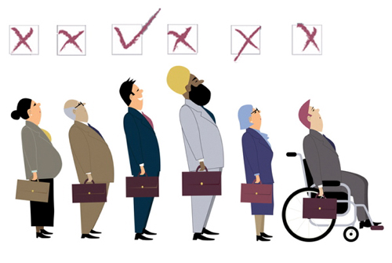
Unwanted bias and algorithmic fairness Machine learning, by its very nature, is always a form of statistical discrimination
Discrimination becomes objectionable when it places certain privileged groups at systematic advantage and certain unprivileged groups at systematic disadvantage
Illegal in certain contexts

Slide 26
Unwanted bias and algorithmic fairness Machine learning, by its very nature, is always a form of statistical discrimination
Unwanted bias in training data yields models with unwanted bias that scale out
Prejudice in labels
Undersampling or oversampling

Slide 27
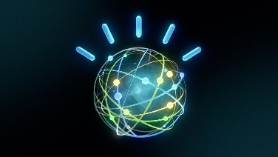
Forces Impacting an AI System
Business Practices
Trying to partition population
Leverage good discrimination
Technical
Market Segmentation
Incremental Rollout
Classification
AI System
Trying to be fair to all
Avoid bad discrimination
Laws
Societal
Expectations
Brand value
Good citizen
Country, State, etc.

Slide 28
21 (or more) definitions of fairness and the need for a toolbox with guidance
There is no one definition of fairness applicable in all contexts
Some definitions even conflict
Requires a comprehensive set of fairness metrics and bias mitigation algorithms
Also requires some guidance to industry practitioners

Slide 29
Defining Bias
There are at least 21 definitions of fairness
- No one definition applicable in all contexts - Some definitions even conflict
Bias does not comes only from training data
- it can also be introduced with
- inappropriate data handling,
- as a result of inappropriate model selection
- incorrect algorithm design or application
Need a "comprehensive Bias pipeline" that fully integrates into the AI Lifecycle

Slide 30
Testing for Bias
Testing/Prod
Data
Test the testing/production data
Appropriate to model/prior assumptions
Representative of intended usage (demographics, conditions)
Cover all potential bias cases
Test the construction of model
Modeling assumptions
Parameter choices
Test training data or prior knowledge
Training
Data
Algorithm
Model
Decision
Test the output decision
Most reliable
Error rates across protected attributes
When to test
ALWAYS!
During development, before deployment
Test after deployment, continuous learning situations
Notes:
Test for adversarial attacks
Not addressed here

Slide 31
AI Fairness 360
Differentiation
Datasets
Toolbox
Fairness metrics (30+)
Fairness metric explanations
Bias mitigation algorithms (9+)
Guidance
Industry-specific tutorials
Comprehensive bias mitigation toolbox (including unique algorithms from IBM Research)
Several metrics and algorithms that have no available implementations elsewhere
Extensible
Designed to translate new research from the lab to industry practitioners (e.g. scikit-learn’s fit/predict paradigm)

Slide 32
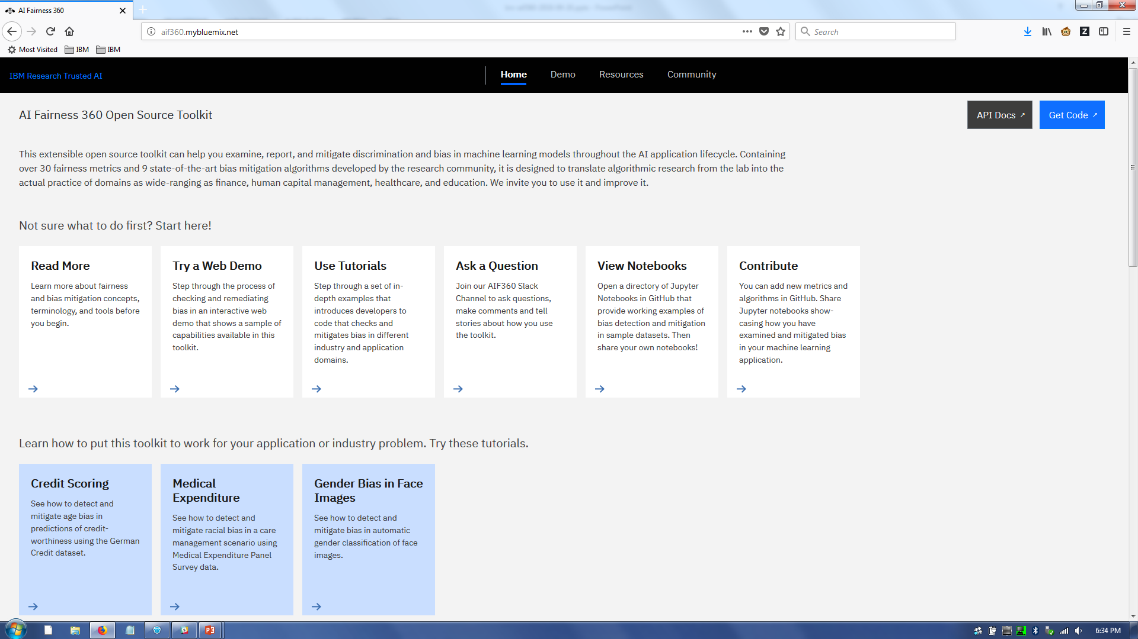

Slide 33
Impact since Launch, Sept 19, 2018
Lots of positive press
Dev Class
Silicon Republic
EE Times
Analytics India
Forbes
TechtheLead
Top 500
The Innovation Enterprise
ZDNet
Database Trends and Applications
Forbes
BBC
Biometric Update
Light Reading
First Pull Request of new Bias detection algorithm
Sept 18, 2018, EPFL
Technical paper to be submitted on Fri, Sept 28
and soon published on arXiv
Discussions with customers, academics, and gov’t agencies

Slide 34
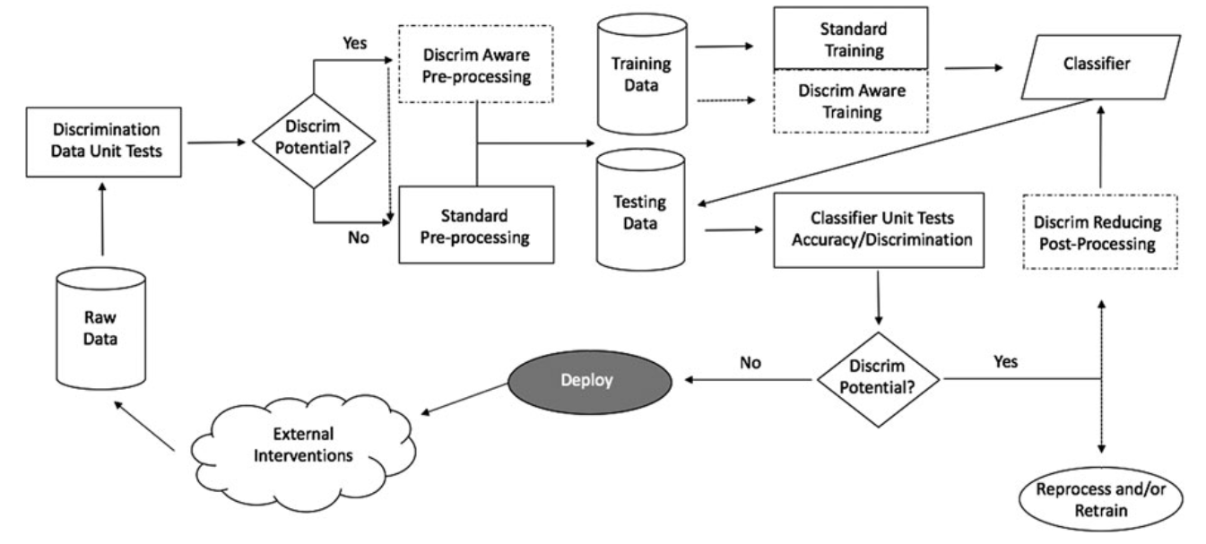
Fairness in building and deploying models
(d’Alessandro et al., 2017)

Slide 35
Metrics, Algorithms
pre-processing algorithm
in-processing algorithm
dataset metric
post-processing algorithm
classifier metric

Slide 36
Metrics, Algorithms, and Explainers
dataset metric explainer
pre-processing algorithm
in-processing algorithm
dataset metric
post-processing algorithm
classifier metric
classifier metric explainer

Slide 37
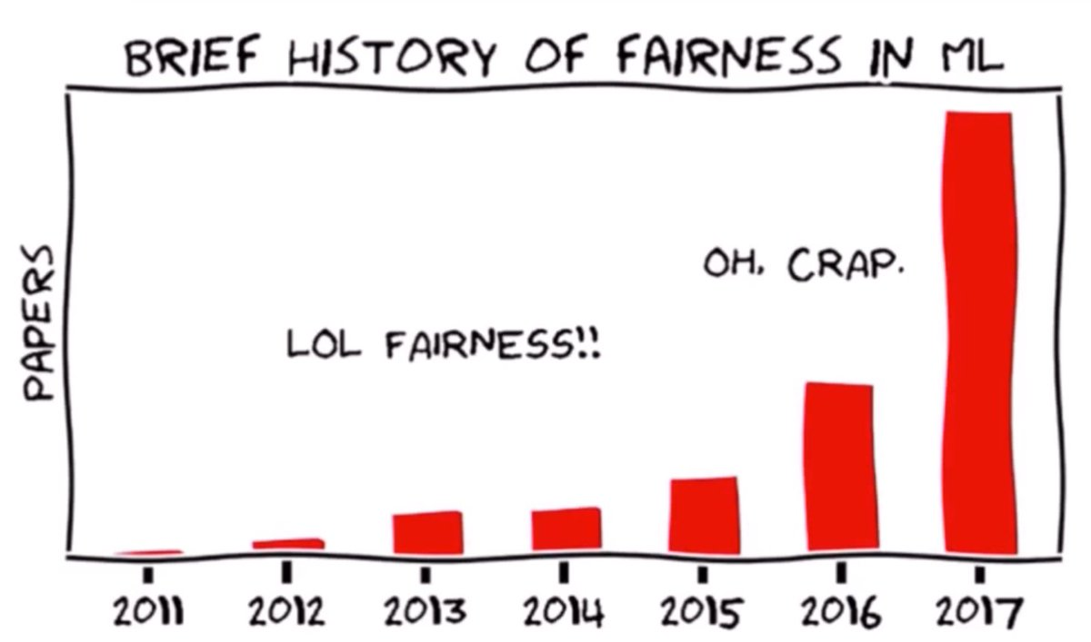
Research Algorithmic fairness is one of the hottest topics in the ML/AI research community
(Hardt, 2017)

Slide 38





05/03/18 |  | Facebook says it has a tool to detect bias in its artificial intelligence | Quartz
05/25/18 |  | Microsoft is creating an oracle for catching biased AI algorithms | MIT Technology Review
05/31/18 |  | Pymetrics open-sources Audit AI, an algorithm bias detection tool | VentureBeat
06/07/18 |  | Google Education Guide to Responsible AI Practices – Fairness | Google
06/09/18 |  | Accenture wants to beat unfair AI with a professional toolkit | TechCrunch

Slide 39
Fairness Measures | Framework to test given algorithm on variety of datasets and fairness metrics | https://github.com/megantosh/fairness_measures_code
Fairness Comparison | Extensible test-bed to facilitate direct comparisons of algorithms with respect to fairness measures. Includes raw & preprocessed datasets | https://github.com/algofairness/fairness-comparison
Themis-ML | Python library built on scikit-learn that implements fairness-aware machine learning algorithms | https://github.com/cosmicBboy/themis-ml
FairML | Looks at significance of model inputs to quantify prediction dependence on inputs | https://github.com/adebayoj/fairml
Aequitas | Web audit tool as well as python lib. Generates bias report for given model and dataset | https://github.com/dssg/aequitas
Fairtest | Tests for associations between algorithm outputs and protected populations | https://github.com/columbia/fairtest
Themis | Takes a black-box decision-making procedure and designs test cases automatically to explore where the procedure might be exhibiting group-based or causal discrimination | https://github.com/LASER-UMASS/Themis
Audit-AI | Python library built on top of scikit-learn with various statistical tests for classification and regression tasks | https://github.com/pymetrics/audit-ai

Slide 40
2018 Selected IBM Research Publications (Fairness/Bias)
Handling Bias in Unstructured Data (Text)
Generating Clues for Gender Based Occupation De-Biasing in Text
EMNLP 2018, Madaan, Singh, Mehta.
Fighting Offensive Language on Social Media with Unsupervised Text Style Transfer
ACL 2018. Nogueira dos Santos, Melnyk, Padhi.
Analyze, Detect and Remove Gender Stereotyping from Bollywood Movies.
FAT* 2018, Madaan, Mehta, et al.
Man Booker Prize Analysis
Paper pending. Mehta et al.
Handling Bias in Unstructured Data (Images)
FairnessGAN
May 2018. Sattigeri, Hoffman, Chenthamarakshan, Varshney.
+ 2 others in preparation
Enabling Trusted AI
Trusted AI Market Places with Privacy Guarantees: A Tale of two hashes.
May 2018. Sarpatwar, Shanmugam, Jagmohan, Vaculin, Ganapavarapu.
Towards Composable Bias Rating of AI Systems
AIES 2018. Srivastava, Rossi.
Increasing Trust in AI Services through Supplier's Declarations of Conformity
August 2018, Michael Hind, Sameep Mehta, Aleksandra Mojsilovic, Ravi Nair, Karthikeyan Natesan Ramamurthy, Alexandra Olteanu, Kush R. Varshney
+ 4 others in preparation
Bias Mitigation
Optimized Pre-Processing for Discrimination Prevention.
NIPS 2017. Calmon, Wei, Vinzamuri, Ramamurthy, Varshney.
+ others in preparation
© 2018 IBM Research AI

Slide 41
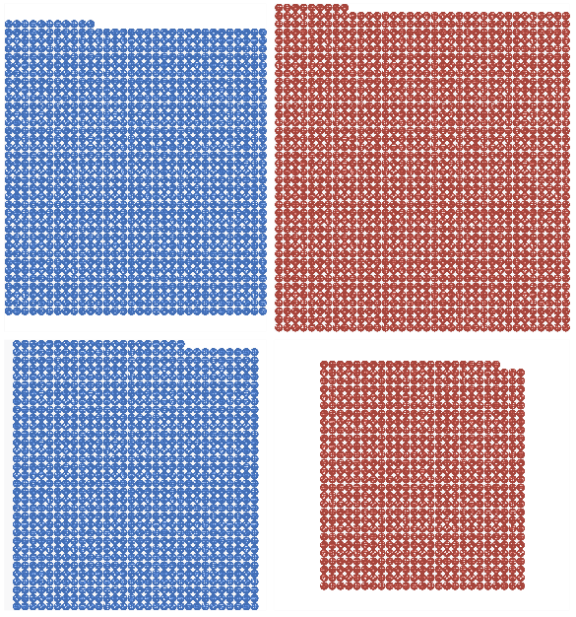
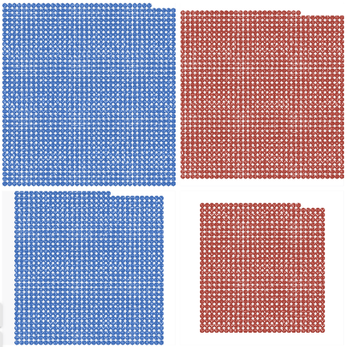
Example of our pre-processing approach (Data)
More denies than approves among African-Americans
Close to equalized proportions of approves and denies
approve
deny
approve
deny
African-American
African-American
56%
46%
Caucasian
42%
42%
Caucasian

Slide 42

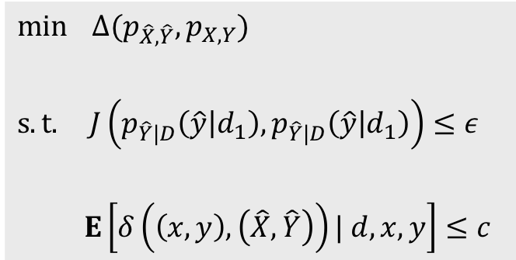




Our Pre-Processing Mitigation Approach
1. Group discrimination
Outcomes made independent of protected attributes
Individual distortion
Avoid large changes in individual features
Utility preservation
Retain joint distribution so model can still learn task
$$\min{ Δ(p_{\hat{X},\hat{Y}}, p_{X,Y})}$$
$$s.t. J\left(p_{\hat{Y}|D}\left(\hat{y} | d_{1}\right),p_{\hat{Y}|D}\left(\hat{y} | d_{1}\right)\right)≤ε$$
$$E\left[δ\left(\left(x,y\right), \left(\hat{X},\hat{Y}\right)\right)| d,x,y\right]≤c$$
$$x,y$$
$$δ$$
$$\hat{x},\hat{y}$$
$$d_{1}$$
$$d_{2}$$
Notes:
#2 motivated by individual fairness, want to respect an individual’s feature values as much as possible especially in testing
#1, #2 conflict

Slide 43
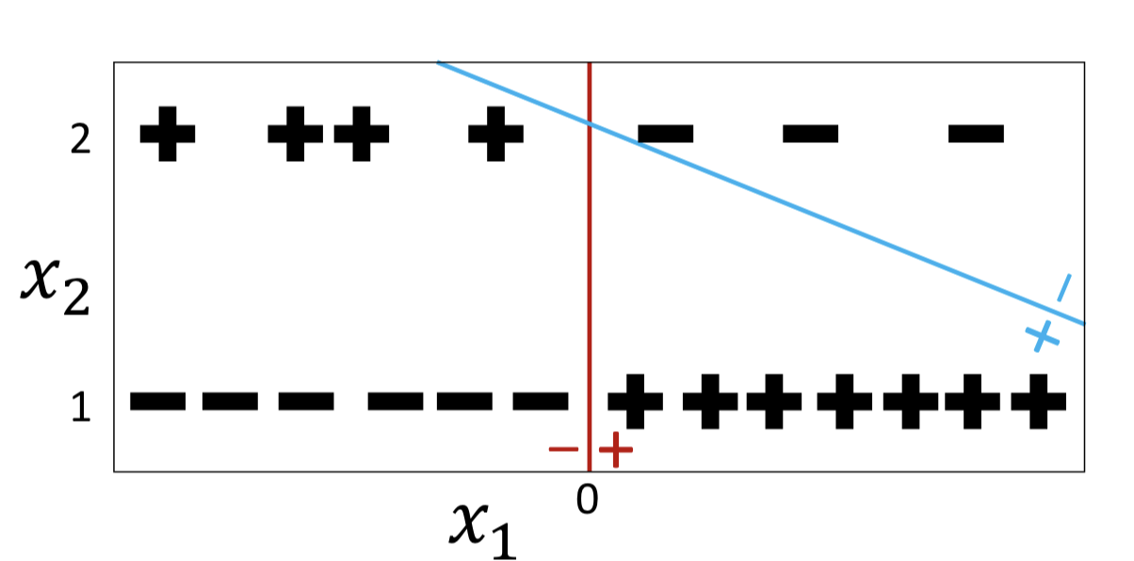
In-Processing Methods
A single classifier can have tradeoffs when trying to maximize the overall accuracy.
It may come at the expense of minority group.
Learn a classifier for each group separately.
Dwork, Cynthia, Nicole Immorlica, Adam Tauman Kalai, and Max Leiserson. "Decoupled classifiers for fair and efficient machine learning." arXiv preprint arXiv:1707.06613 (2017).
Notes:
Paper also shows how to use protected group information in a beneficent way.
Postprocessing:
Hardt, Moritz, Eric Price, and Nati Srebro. "Equality of opportunity in supervised learning." In Advances in neural information processing systems, pp. 3315-3323. 2016.

